Slide 1

Sign Language to Speech Conversion with Deep Learning
This presentation outlines a project to create a real-time sign language to speech conversion system. It utilizes deep learning techniques to bridge the communication gap. The goal is to improve accessibility and inclusivity for the deaf and mute community.

Slide 2
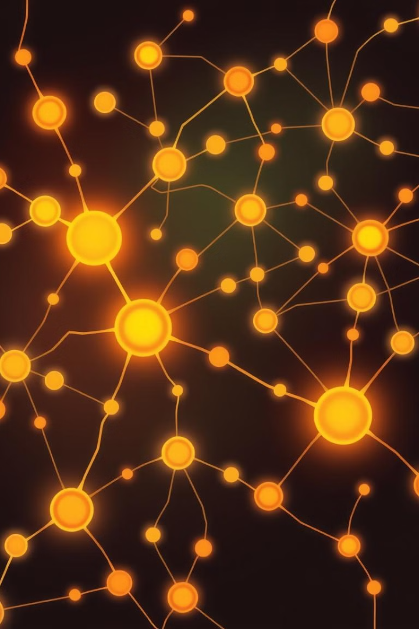
Project Abstract
Project Overview
Converts sign language to spoken language using deep learning.
Key Objective
Bridge communication gap for deaf/mute individuals.
Core Technology
Employs RNNs and CNNs.
Expected Outcome
Real-time, accurate sign language translation using datasets like ASL.

Slide 3

Introduction: Breaking Communication Barriers
Background
Significance
Deep Learning Rationale
Communication barriers faced by sign language users.
Fosters inclusivity and accessibility in daily life.
Enables automated, real-time, and accurate translation.
Existing solutions rely on human interpreters and have low accuracy. Deep learning enables automated translation. Hearing loss affects millions worldwide, making this project critical.

Slide 4
Problem Statement: Bridging the Divide
Core Issue
Inefficient Communication
Accessibility Limitations
Communication difficulties between sign language users and others.
Reliance on interpreters is costly and slow.
Lack of widespread translation tools.
The project aims to solve the difficulties in communication between sign language users and others by providing affordable translation tools.

Slide 5
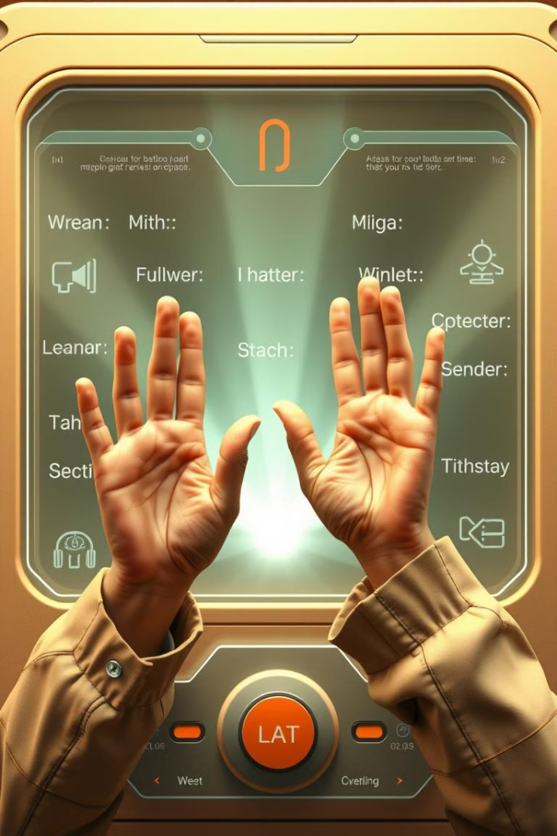




Project Objectives: Achieving Seamless Translation
Primary Goal
Accurately translate sign language into speech.
Target Accuracy
Achieve a high accuracy rate translating common phrases.
Minimize Latency
Enable real-time conversion.
User-Friendly Interface
Create an easy-to-use interface.

Slide 6
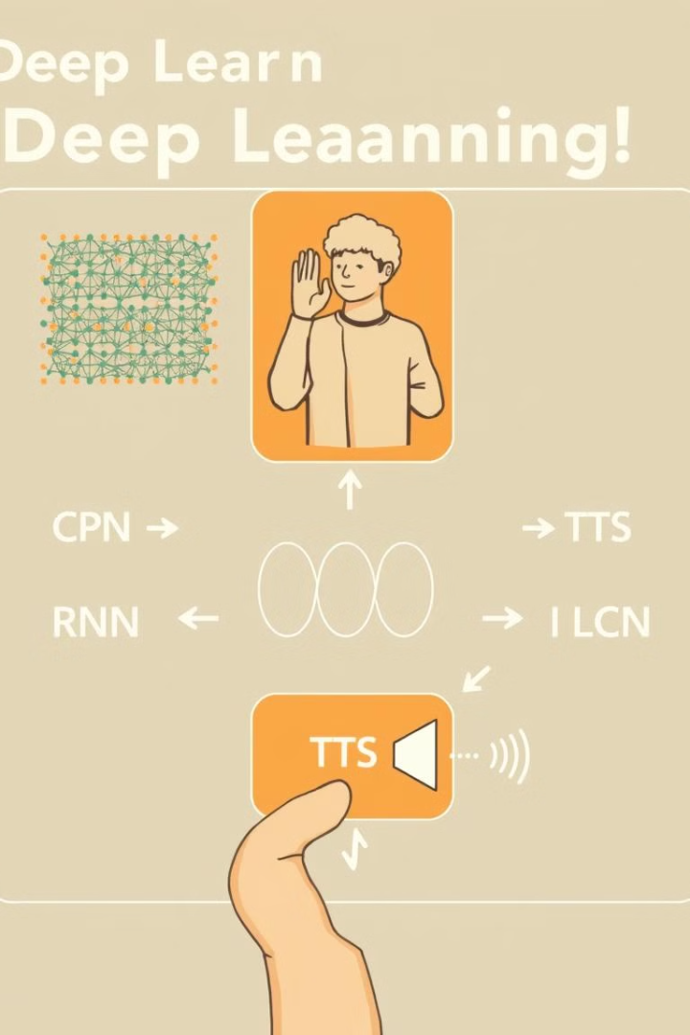




Methodology: Deep Learning Architecture
Input Data
Video feed of sign language gestures from webcam.
Feature Extraction
CNNs extract spatial features like hand shape.
Sequence Modeling
RNNs model temporal dependencies in sign sequences.
Speech Synthesis
TTS system converts predicted text into spoken language.

Slide 7
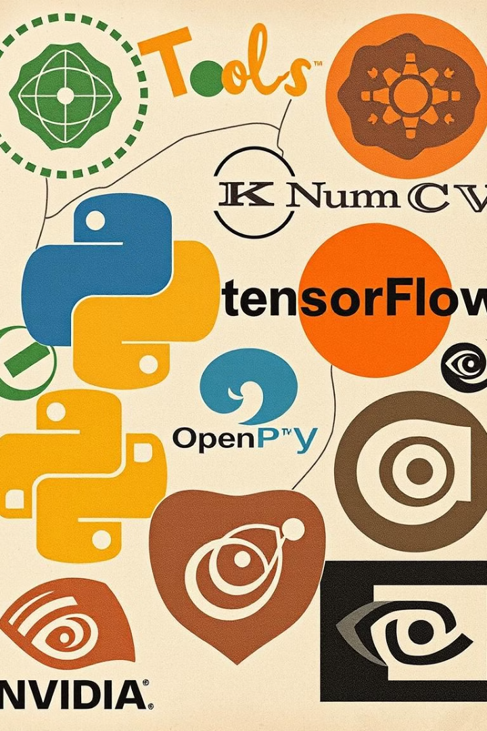




Tools and Technologies
Python
TensorFlow & Keras
OpenCV
NVIDIA GPU
Core technologies include Python, TensorFlow, and Keras. Image processing utilizes OpenCV, and numerical computation relies on NumPy. Training requires a powerful NVIDIA GPU. The ASLLVD dataset is crucial for training.

Slide 8

Expected Outcomes and Conclusion
Deliverable
Societal Impact
Functional sign language to speech conversion prototype.
Improved communication accessibility for the deaf/mute community.
Future Work
Integration into mobile apps, expansion to other languages.
The project aims to deliver a functional prototype improving accessibility for the deaf community. Future work includes expanding into mobile applications and other sign languages.

